Slide 1

Module 1:
Presuppositions and
Your Ultimate
One

Slide 2
Why this course?
Help to
  Give good reasons for Christianity being true
  Identify faulty argumentation
  Aid evangelism
Show you how to demonstrate the ultimate
proof of Christianity:
that without the Christian God,
you couldn't know anything

Slide 3
Concepts
Basic Assumptions

Slide 4
Both Christians and Non-Christians
Have basic assumptions that we take for granted and do not feel
need to be proven
Examples:
  Others should respect me
  Others should not lie to me
  Truth in morality exists
  Gravity will work the same tomorrow as it did today
  Human sense perception is reliable
  I should love, not eat my neighbor

Slide 5
Concepts
Basic Assumptions
Can we eliminate basic assumptions?

Slide 6
No
Why?
We will always need to assume something
Because no human knows everything
Do you know someone who does?

Slide 7
Concepts
Basic Assumptions
Can we eliminate basic assumptions?
Your Ultimate Assumption

Slide 8

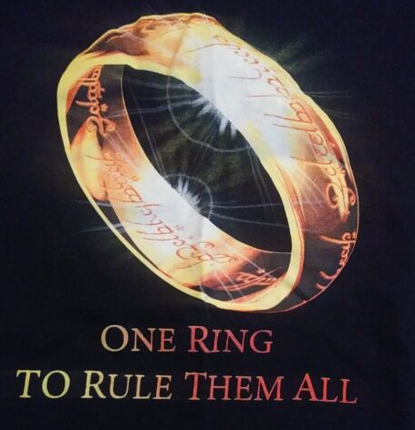
We all have basic assumptions
But there is only one ultimate assumption
which governs/rules all other assumptions
Your ultimate basic assumption
is NOT able to be supported
by something else

Slide 9
Concepts
Basic Assumptions
Can we eliminate basic assumptions?
Your Ultimate Assumption
What is your Ultimate Assumption?

Slide 10
For the Christian,
It’s God
For the unbeliever
it's himself.

Slide 11
Concepts
Basic Assumptions
Can we eliminate basic assumptions?
Your Ultimate Assumption
What is your Ultimate Assumption?
What does your UA do?

Slide 12




Our Ultimate Assumption
Is our ultimate authority
It determines...
- how you test things
- how to determine facts
- how we come to know
something is true
Notes:
Examples of presuppositions in our worldview:
-only the material world exists
-Miracles are not possible
-gravity will work tomorrow as it did today
-I can trust my eyesight when driving my car
Epistemology is – how do you know what you know.
Ontology is – what is actually out there

Slide 13
Examples
Is it true?
  Christian: what does God say?
  Unbeliever: do I want it to be true?
Is there life after death?
  Christian: what does God say?
  Unbeliever: what does man say?
What does it mean to thrive/prosper?
What does success look like?
What is the moral thing to do?

Slide 14
Concepts
Basic Assumptions
Can we eliminate basic assumptions?
Your Ultimate Assumption
What is your Ultimate Assumption?
What does it do?
It determines our Point of View of reality

Slide 15


Our ultimate assumption determines our Point of View
Point of View (worldview):
A web of inter-connected beliefs,
with some privileged
above others.
Our Ultimate Assumption is above them

Slide 16
Concepts
Basic Assumptions
Can we eliminate basic assumptions?
Your Ultimate Assumption
What is your Ultimate Assumption?
What does it do?
It determines our Point of View of reality
Only 4 main ones

Slide 17
There aren't that many
Points of View of reality
Materialism (all is physical)
Dualism (physical and spiritual)
Polytheism (multiple gods)
Monotheism (one God)
Many would have you believe there are 1000's of Points of View
And that we are hopelessly unable to assess them all in one human lifetime

Slide 18
Concepts
Basic Assumptions
Can we eliminate basic assumptions?
Your Ultimate Assumption
What is your Ultimate Assumption?
What does it do?
It determines our Point of View of reality
Only 4 main ones
Are there brute facts?

Slide 19

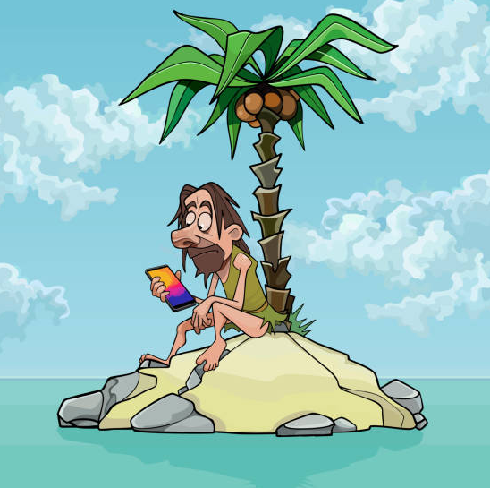
There is no such thing
As a brute fact
That "just is"
And exists
without a Point of View
On an island by itself

Slide 20

Brute Facts
live inside a Point of View,
People often act as if they have nothing to do with your POV – they do.

Slide 21
Example
Alleged
Brute fact: Do no harm to others
If the material POV is true, why are we appealing to an immaterial ethic?
Moral oughts are not made of material.
Who cares what pond scum does to pond scum?
Does anyone cry when a rock falls off a cliff? (our supposed ancestors)
How does does a materialist "know" his ethic is right? (Mother Theresa vs. Hitler)

Slide 22
Concepts
Are there brute facts?
How are these connected?

Slide 23
All thoughts amount to
What you know
How you came to know it
What you do about it

Slide 24

Putting it together
Knowledge
  Is what you know
Epistemology
  Is how you came to know it
Ethics
  How you ought to apply that knowledge
Example:
  Logic exists (if this, then that)
  God made us in His imagers and He revealed Himself to us
  We ought to therefore be logical

Slide 25
Concepts
Are there brute facts?
How are these connected?
Facts alone don't matter to people

Slide 26


Juries every day
Demonstrate
That the same information
Results in different
conclusions
That is why facts
do not exist on their own
Information has to
be interpreted
with a
Point of View
What are the 4 main ones?

Slide 27
The 4 main Points of View
Materialism (all is physical)
Dualism (physical and spiritual)
Polytheism (multiple gods)
Monotheism (one God)

Slide 28
Concepts
Are there brute facts?
How are these connected?
Facts alone don't matter
Our Point of View determines our beliefs

Slide 29

They're like buss stops
You can't stop wherever you want
Destinations are limited by your Point of View (POV)

Slide 30
An Example:
The materialist POV is limited to material-only explanations
The Christian POV denies that only the material exists
Knowledge (what is the perceived fact?)
  Material or material and immaterial exist?
POV (the lense you look at it with)
  Materialism or Christianity
Ethic
  Believe what is true

Slide 31
Another way to look at it
Someone says something
(a fact claim)
You compare it with your POV
(and your UA in that POV)
Then you determine what ought to be done.

Slide 32
Concepts
Are there brute facts?
How are these connected?
Facts alone don't matter
Our Point of View determines our beliefs
How do we see this on a daily basis?

Slide 33

This is what happens
The unbeliever thinks he can
take only the
parts he likes
from the
Christian Point of View
But reject the rest
of Christianty
ie.) Love your neighbor
instead of eat your
neighbor
is a Christian value

Slide 34
The idea of
"I can be good without God"
And
"I can live by the selected Christian morals that I like, yet not be loyal or subject to God"
(even though those morals cannot be sustained by my own POV)
Is stealing from God
It is active rebellion

Slide 35
Why is it wrong to
"be good without God?"
Christ is king and has a claim on us.
If we claim ourselves as the UA, we claim kingship over our own lives
What happens when two kings dispute over the same claimed territory? War
Is war against the King one you can win?
Those who are not subject to the King are resisting His claim on them
Only through Christ can we be made a subject of God and His kingdom (Rom 5:11)

Slide 36
Here is a summary of
The basic flow of how knowledge works

Slide 37
Knowledge Flowchart
Basic Assumptions (common experience)
  |(induction, sense perception)
Ultimate Assumption + Authority (God or self)
|(determines our Point of View)
Point of View
|(contain a web of beliefs)
Beliefs
|(used to determine...)
Facts/Evidence/Proof/Truth
|(Is where many people incorrectly start)
Notes:
The closer to the top you are, the more basic
your assumptions are
The further to the bottom you are,
the more assumptions you have
which are built on top of one another

Slide 38
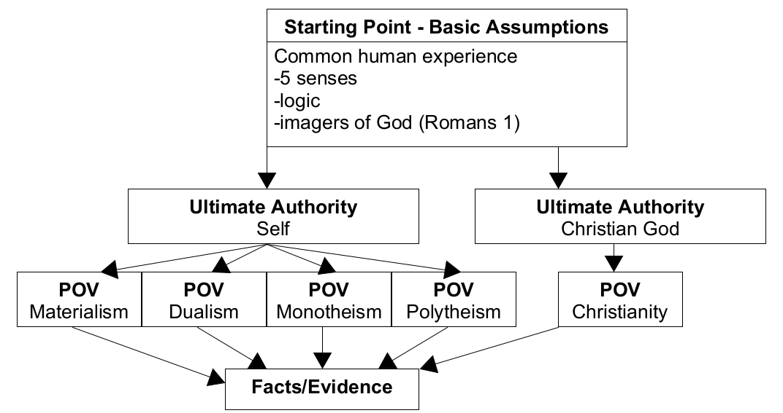
Graphical Chart

Slide 39
Comprehension Questions
What is a basic assumption?
What is worldview?
Are there brute facts? Why not?
What justifies an ultimate standard?
What are the two competing authorities?
What do our assumed starting points determine?
Notes:
-presupposition: An assumption so basic that it cannot be supported by anything else
-myth: There are brute facts that you must agree to. We can use our authority of self, but you are not allowed to use your authority, the Christian God
Brute facts?
No, they live inside worldviews, being interpreted via basic assumptions
-Ultimate standard:
An ultimate standard can only justify itself
-2 competing: God and self

Slide 40

The relationships between
  Basic assumtions
  Our Ultimate Assumption
  The resulting POV
  And the resulting beliefs
Why "just the facts" don't convince everyone

Slide 41

Next Module:
Building a Worldview

Slide 42

End of Module 1
Questions?

